Slide 1

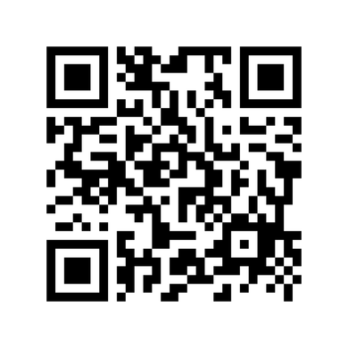
Mission PresbyteREADs
Theo of Golden by Allen Levi
Read a good book lately?
The Connect Committee of Mission Presbytery invites you to join the conversation this spring for our very first PresbyteREADS!
How will PresbyteREADS work?
Read Theo of Golden by Allen Levi on your own. After Easter, groups will form in each Presbytery region and virtually to gather and discuss this beautiful story. Sign up using this QR code to be notified as soon as gathering details are available.

